Slide 1

Field Goal Probability Model
Created By: Andrew Purvis

Slide 2
Data and Features Used FOR Model
Play-by-Play Data Retrieval from NFLVerse GitHub for years 2016-2024
Pre-processed the data to get only Field Goal Attempts and removed any unnecessary columns
Replaced NaNs in temperature and wind data for closed stadiums
70 degrees and 0 MPH
Final Features
Simple Features | Extracted Features
Kick Distance | Kicker’s Season FG% Prior to Attempt
Temperature | Kicker’s Career Long Prior to Attempt
Wind | Kicker’s FG% in Bin Range Prior to Attempt
Score Differential | League FG% from Specific Distance
Quarter | Binary for Closed or Open
Seconds Remaining in Quarter | Binary for Grass or Turf
Seconds Remaining in Game | Binary for Home or Away

Slide 3
Final Model Summary
Logistic Regression (80% Weight)
Trained on All Data
Data Normalized
Recognize Linear Trends
AUC: 0.7926
Ensemble (Final Model)
Blends Together Both Models
Increases Accuracy
XGBoost Classifier (15% Weight)
Trained on 80/10/10 Split
Data Normalized
Recognize Nonlinear Trends
AUC: 0.7894

Slide 4
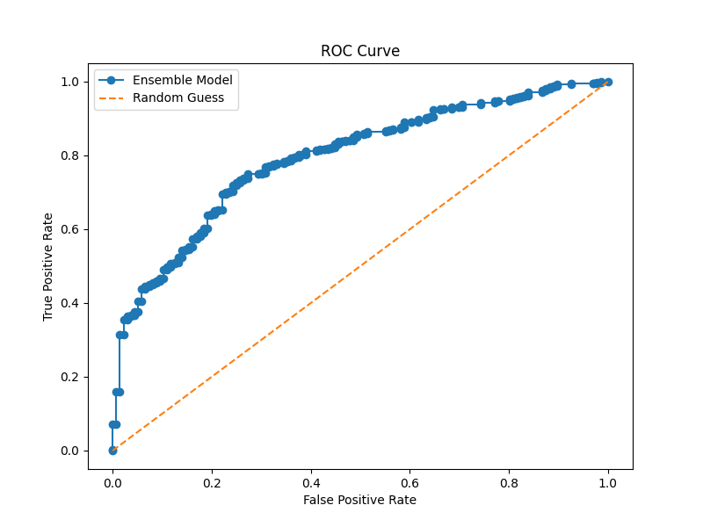
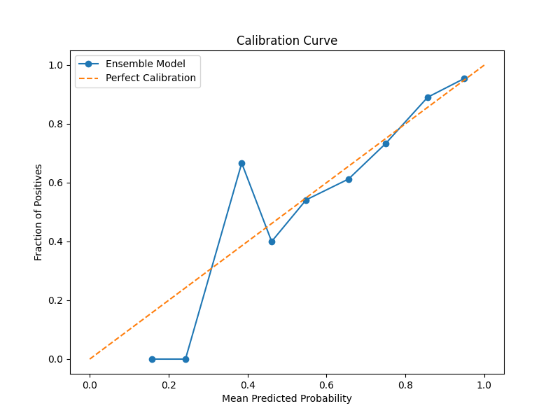
Accuracy Metrics and Charts
Final Test Ensemble AUC: 0.7928
Calibration Curve from Our Model
The Model’s 0.7928 AUC indicates the ability to distinguish between miss and make. The calibration curves show near-perfect calibration for high and medium probability ranges, but there are miscalibrations for the lower probability ranges (below 50%), which is likely due to the smaller amount of data for these kicks.

Slide 5
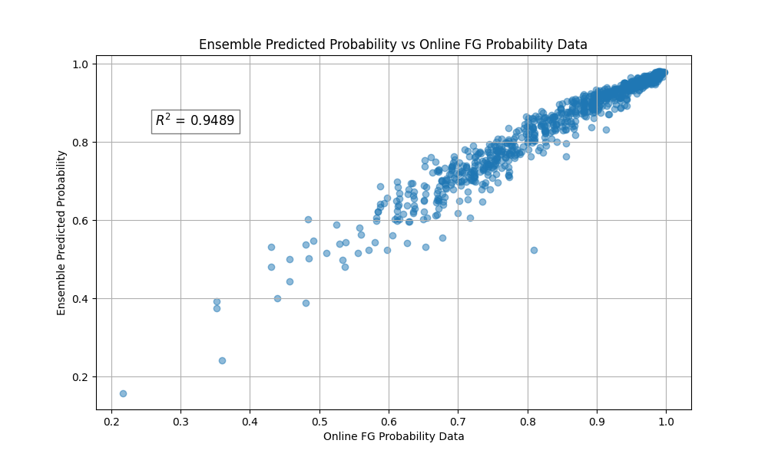
Accuracy Metrics and Charts (Cont.)
Prediction Compared to NFLVerse FG Prob. Model
However, the scatter plot supports that the model performs well, with an Adj. R-Squared of 0.9489 in comparison to the NFLVerse FG Probability Data. With the combination of the AUC-ROC Curve, Calibration Curve, and Adj. R-Squared, this model is considered a viable and reliable tool for FG Probability Analysis.

Slide 6
Assumptions and Key Decisions
Assumptions
Years 2016-2024 give enough data points to provide the most recent insight into future kicks
AUC is the right metric because probability performance is more important for future football decisions
Stadium-specific data did not have enough volume to affect the model positively
Environment Features will be known in real time to make valuable game decisions
Key Decisions
Creating a blended Ensemble of the two models to balance out the accuracy issues of either model and improve overall AUC
Run GridSearchCV to discover the best parameters for the XGBoost Model
Removed Unnecessary Features that had little effect on the model (Multiple Tests)
Scaled all the data to ensure no feature overpowered any other feature
Remove Kicks from Kickers with less than 15 Total Attempts over the last 9 years (Eliminates Excess Noise)

